Slide 1


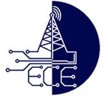
Real-Time Mobile Phone Usage Detection and Automated Ticketing Using YOLO Deep Learning Algorithm
Department of
ELECTRONICS AND COMMUNICATION ENGINEERING
Guided by
Dr.C.KUMAR, Ph.D
Presented by
M.VAMSI KRISHNA : 21691A04Q9
P.VENU KUMAR : 21691A04R9
M.VISHNUVARDHAN : 21691A04T0

Slide 2
Abstract
Using mobile phones while riding two-wheelers is risky and breaks traffic rules. This project uses a YOLOv8 model on a Raspberry Pi to detect such violations in real-time. It captures images, reads number plates using OCR, and sends automated e-tickets. The system achieved 92.7% accuracy (mAP at IoU=0.5), offering a low-cost, effective solution to improve road safety and enforce traffic laws.

Slide 3
Literature Survey
[1] Thresholding for Image Segmentation
N. Otsu (1979)
Proposed Otsu’s method for optimal threshold selection from grayscale histograms.
Widely used in image preprocessing and binarization.
[2] Text Detection in Images and Videos
A. Jain & B. Yu (1998)
Developed a method for automatic text location in both static images and video frames.
Useful in license plate detection and OCR preprocessing.
[3] Multiobjective Optimization in Detection Models
K. Deb et al. (2002)
Introduced NSGA-II, a fast elitist genetic algorithm.
Helps in optimizing deep learning parameters for better accuracy.

Slide 4
Introduction
This project detects mobile phone usage by two-wheeler riders in real-time.
It uses the YOLO deep learning model and a Raspberry Pi for processing.
A USB webcam captures live video of the riders.
YOLO analyzes the video to check if a rider is using a mobile phone.
If a violation is found, the number plate is read using Tesseract OCR.
An LCD screen displays the detected information.
The system helps improve road safety by detecting and reporting violations automatically

Slide 5
Proposed Method
uses YOLO to detect mobile phone use by two-wheeler riders in real time.
A USB webcam captures live video of the rider.
YOLO checks the video instantly to see if the rider is using a phone.
If a violation is found, Tesseract OCR reads the number plate.
The system works automatically without human help.
The system It quickly issues tickets after detecting a violation.
This helps improve road safety and makes monitoring easier

Slide 6
Existing Method
Most systems use manual monitoring or fixed CCTV cameras.
They need humans to watch videos and give tickets, which is slow.
They can’t detect phone usage accurately in real-time.
Many systems don’t send tickets automatically, causing delays.

Slide 7
Yolo v8 block diagram
Input: Live Camera Feed(Raspberry pi)
Preprocessing(Frame Extraction)
Object Detection Model(YOLOv8) Detects Two-Wheeler Vechicles Detection
Post-Processing (Filtering & Validation) Checks if Rider is Holding a Mobile Phone Ensures Correct Detection
Automated Ticketing System Captures Vehicle Number Plate Logs Violation Data Sends Automated Ticket
Output: Violation Report & Alert

Slide 8
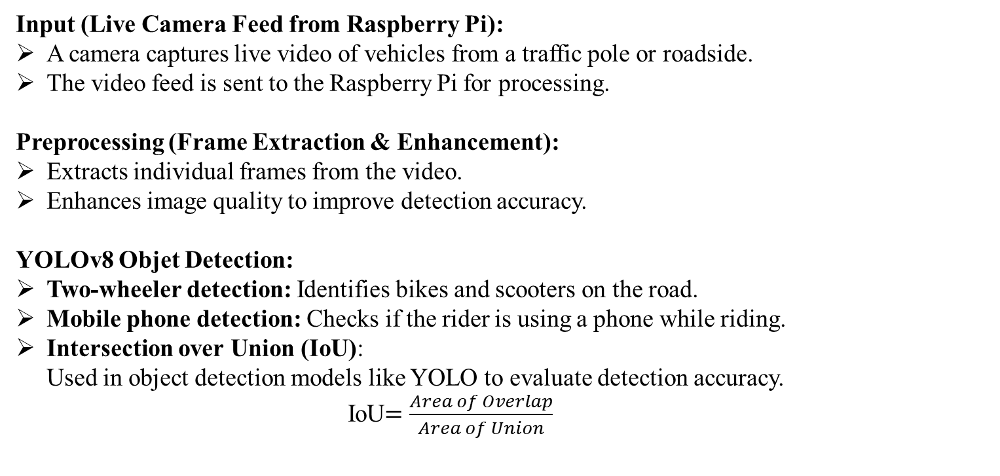
Explanation
Input (Live Camera Feed from Raspberry Pi):
A camera captures live video of vehicles from a traffic pole or roadside.
The video feed is sent to the Raspberry Pi for processing.
Preprocessing (Frame Extraction & Enhancement):
Extracts individual frames from the video.
Enhances image quality to improve detection accuracy.
YOLOv8 Objet Detection:
Two-wheeler detection: Identifies bikes and scooters on the road.
Mobile phone detection: Checks if the rider is using a phone while riding.
Intersection over Union (IoU): Used in object detection models like YOLO to evaluate detection accuracy.
IoU$=\frac{Area of Overlap}{Area of Union}$

Slide 9
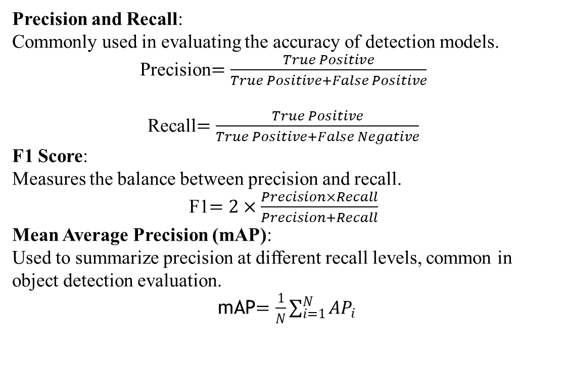
Explanation
Precision and Recall: Commonly used in evaluating the accuracy of detection models.
Precision$=\frac{True Positive}{True Positive+False Positive}$
Recall$=\frac{True Positive}{True Positive+False Negative}$
F1 Score: Measures the balance between precision and recall.
F1$=2×\frac{Precision×Recall}{Precision+Recall}$
Mean Average Precision (mAP): Used to summarize precision at different recall levels, common in object detection evaluation.
mAP$=\frac{1}{N}\sum_{i=1}^{N}{{AP}_{i}}$

Slide 10
Explanation
Post-Processing (Filtering & Validation):
Removes false positives using confidence scores and object positions.
Validates that the mobile phone is in the rider’s hand, not elsewhere.
Automated Ticketing System:
Number Plate Recognition: Uses Tesseract OCR to read the vehicle’s number plate.
Violation Logging: Saves data such as time, vehicle number, and location in a database.
Alert Generation: Automatically sends a fine or warning to the vehicle owner.
Output (Violation Report & Alert):
The system logs the violation.
Notifications are sent to authorities or directly to the violator.

Slide 11
System Architecture
Raspberry pi
YOLOV8
Detection
Number Plate
Extraction
Image
Acquisition
Text Recognition using Tesseract-OCR
Email
Notification

Slide 12
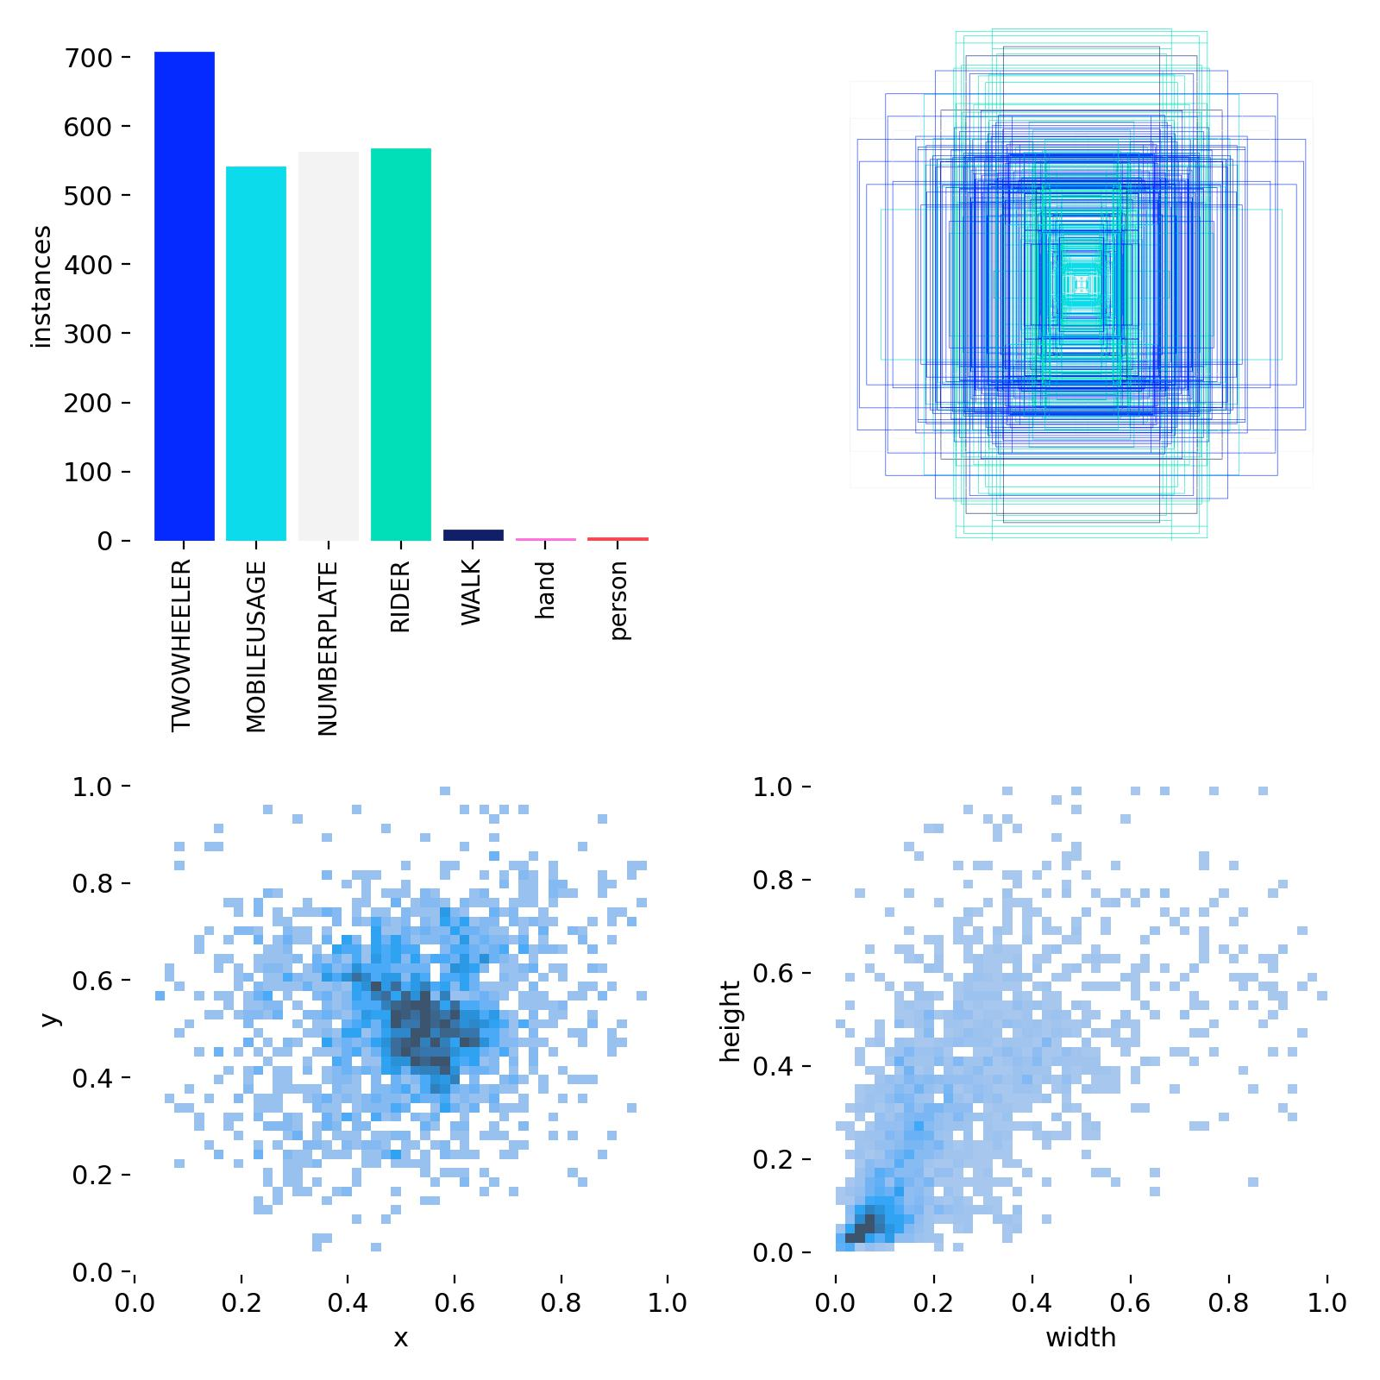
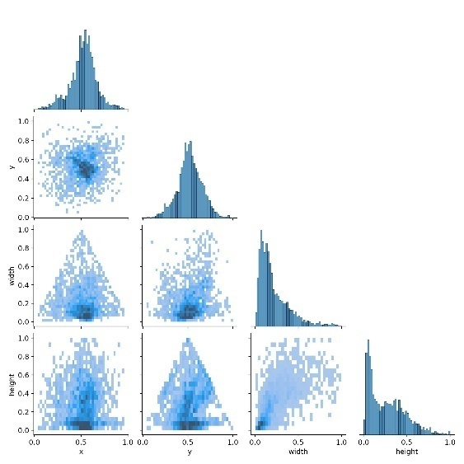
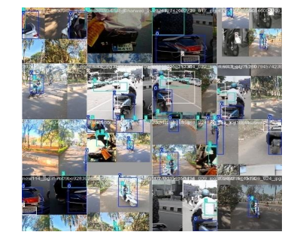
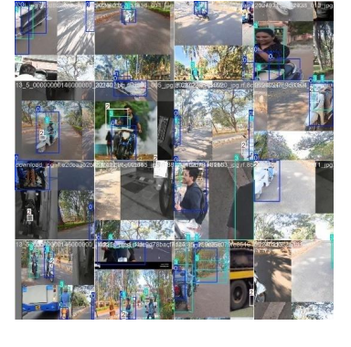
Trained Dataset Sample Images
Dataset Collection and Labeling
Object Tracking Output Using DeepSORT for Consistent Rider Identification

Slide 13
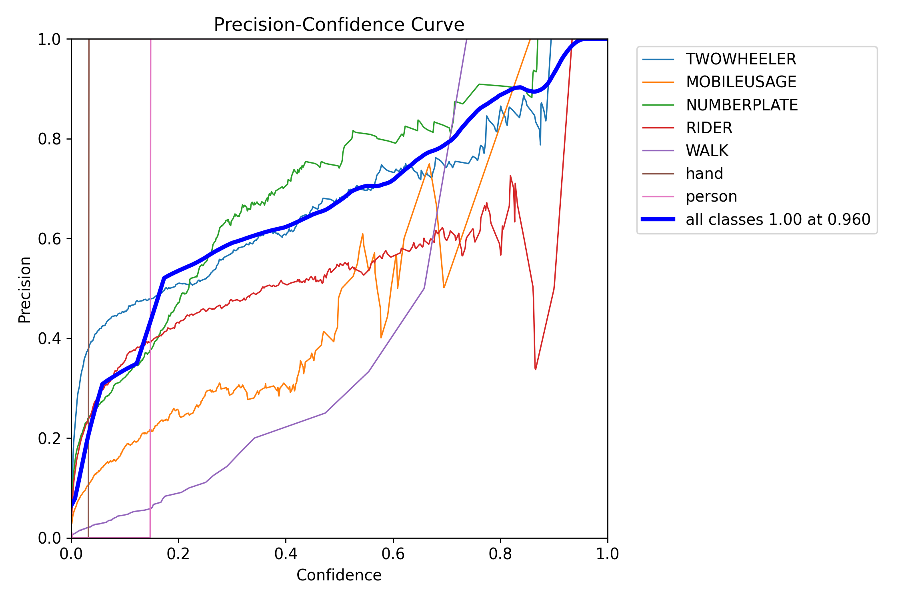
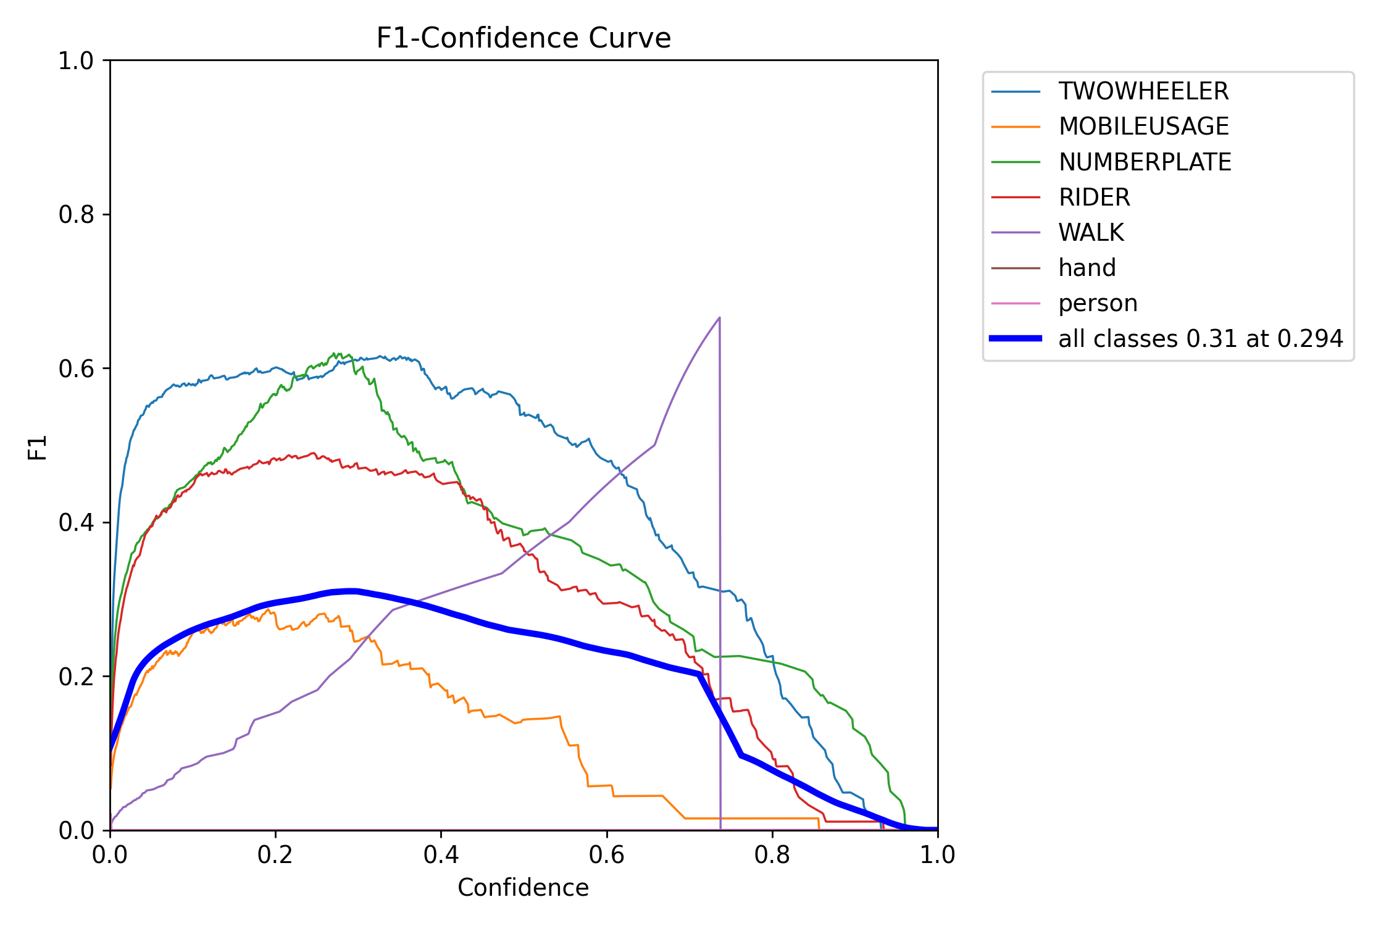
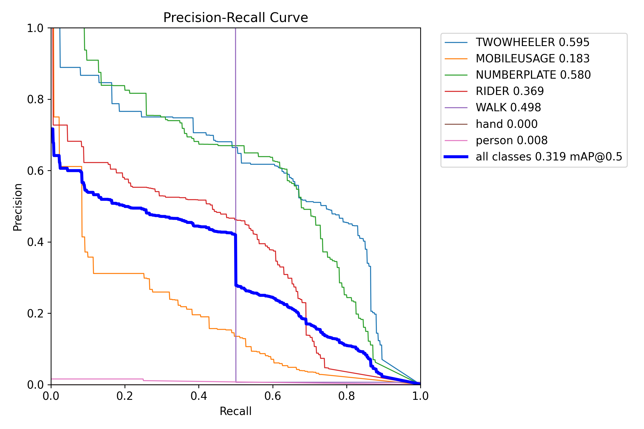
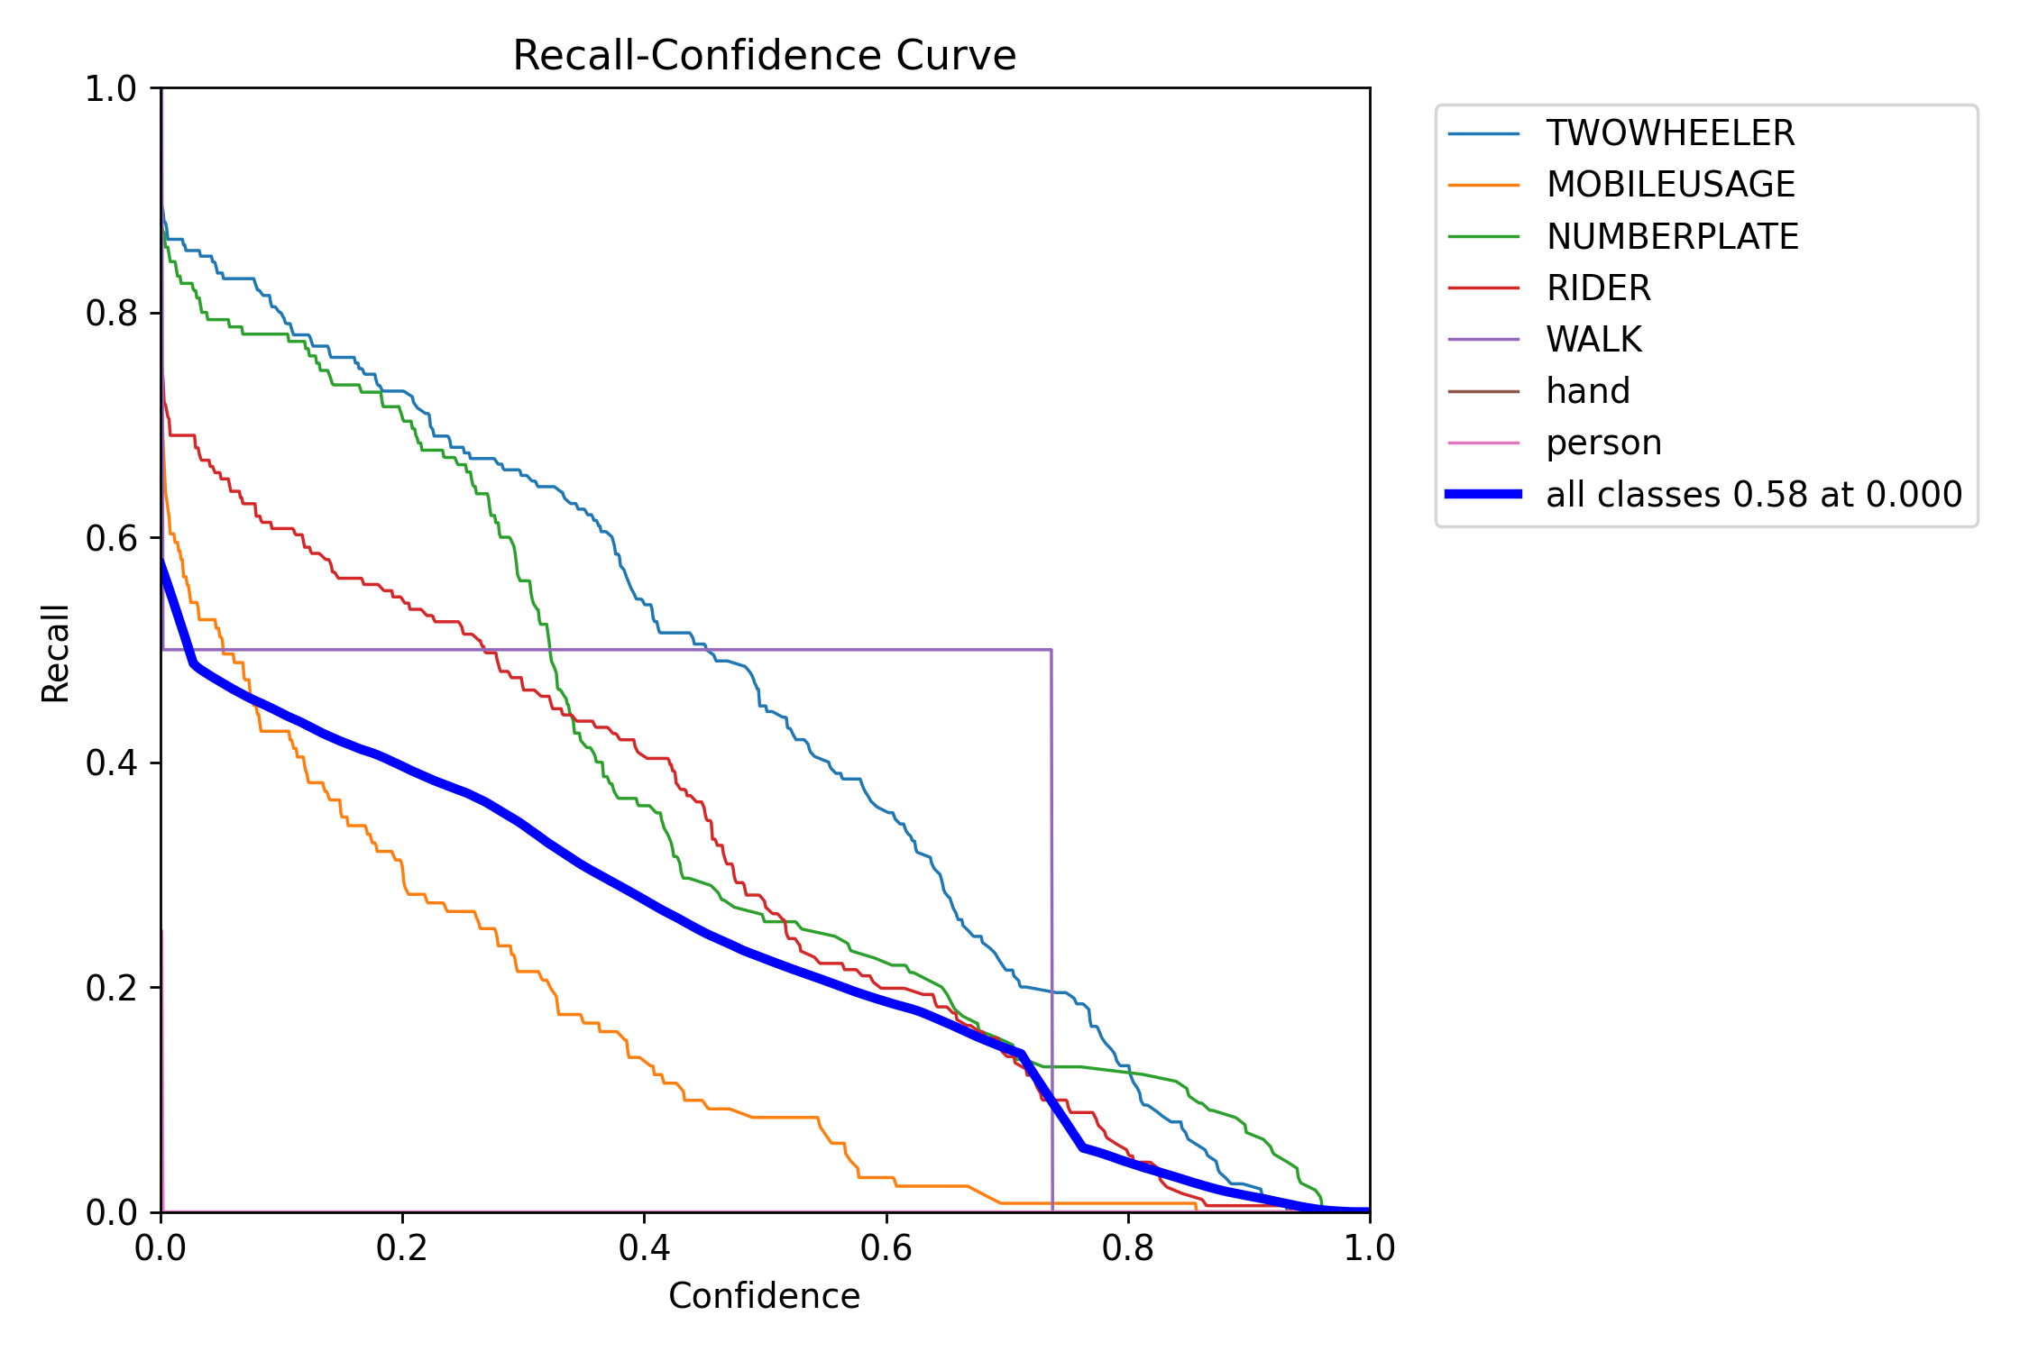
Outputs Graphs
F1 score and precision vs. confidence curves for YOLOv8 multi-class detection performance.
Recall-confidence and precision-recall curves depicting model detection quality.

Slide 14
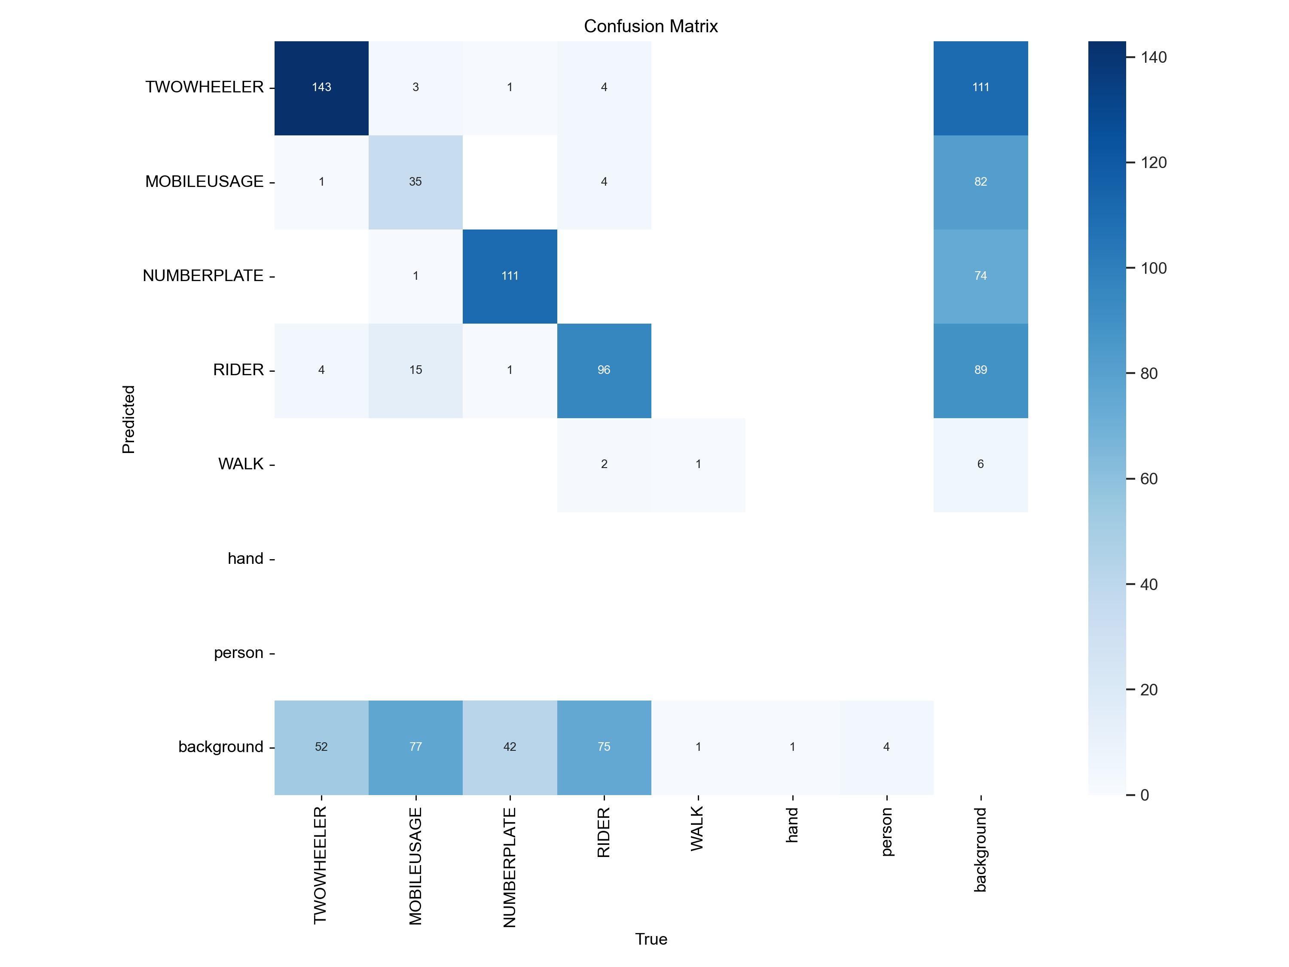
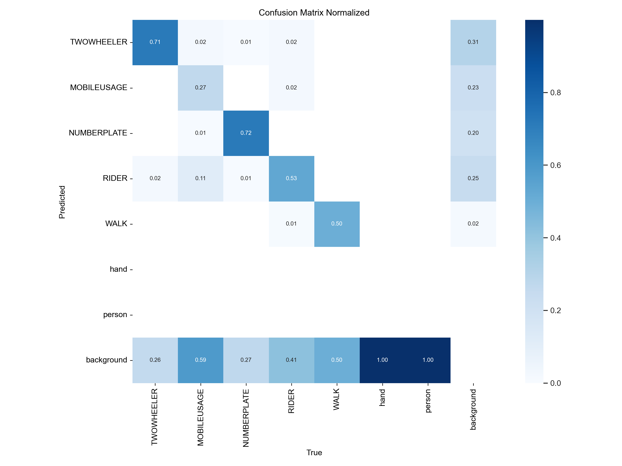
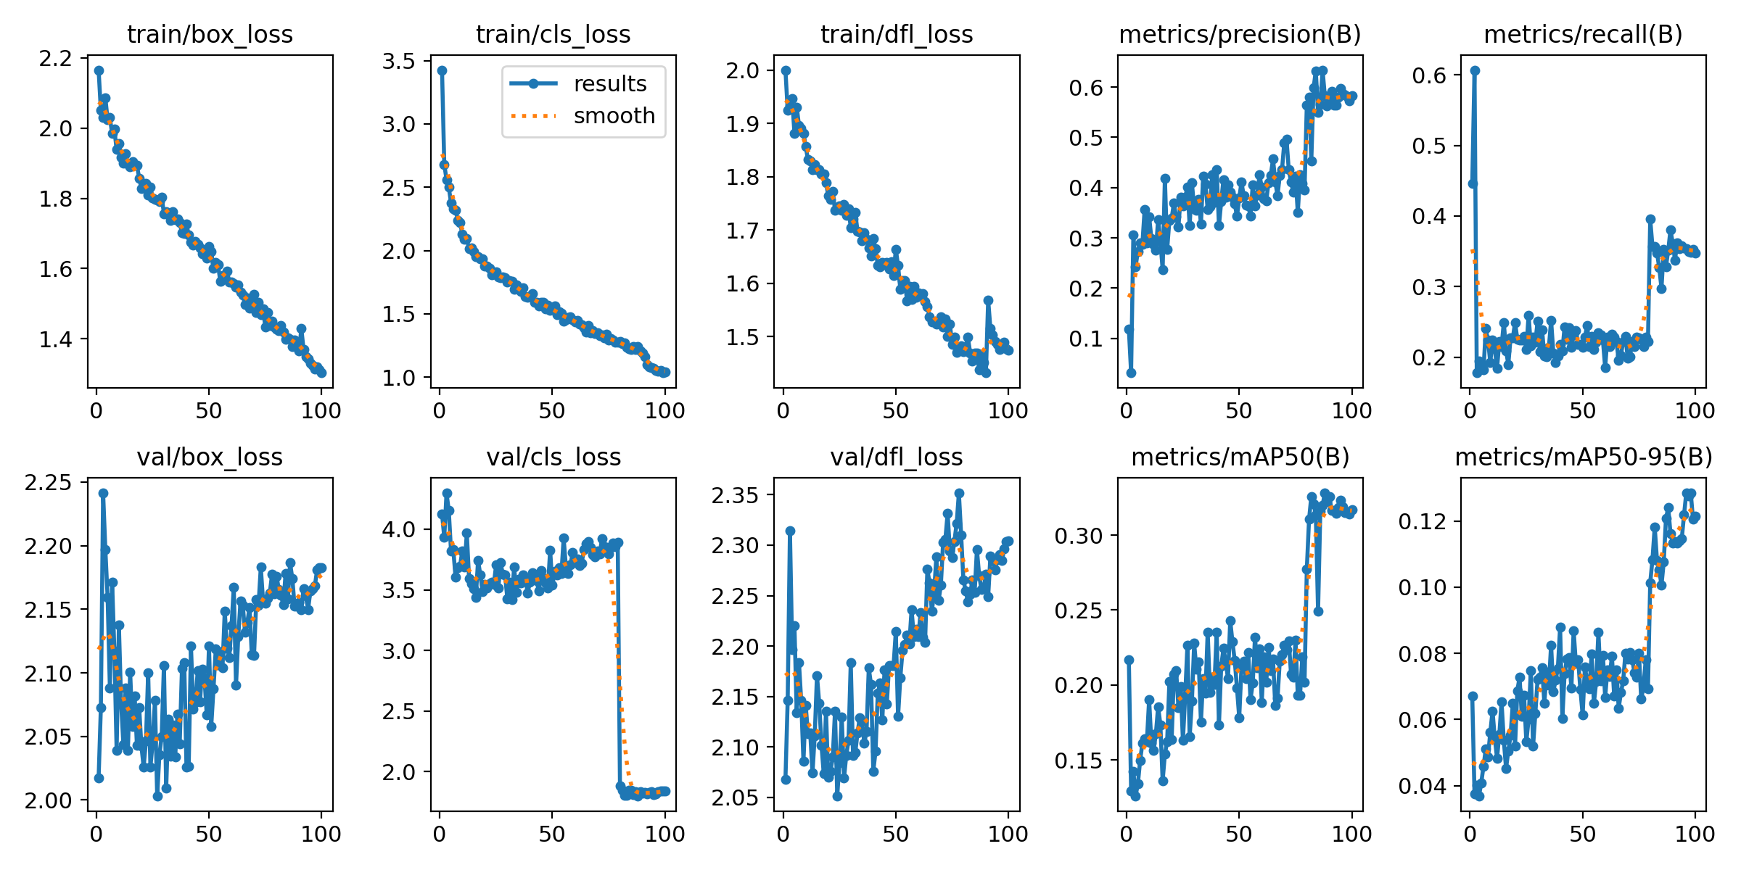
Outputs Graphs
Normalized confusion matrices for multi-class classification of riders, mobile phone users, and license plates.
Training and validation loss and metric trends for the YOLOv8 model over 100 epochs.

Slide 15
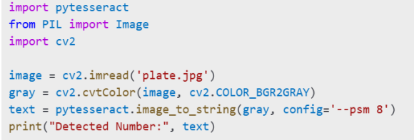
Python Code to Detect Number Plate

Slide 16
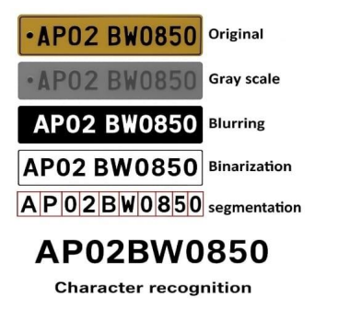
Number Plate Recognition
Using Tesseract OCR

Slide 17
Number Plate Detection Outcome
on Dataset
S.No. | Stage | Number of samples | Number plate visible/Readable | Correct Predictions | Success Rate(%)
1 | Detection | 500 | 475 | 448 | 94.3%
2 | Segmentation | 500 | 460 | 432 | 93.9%
3 | Recognition | 500 | 450 | 410 | 91.1%

Slide 18
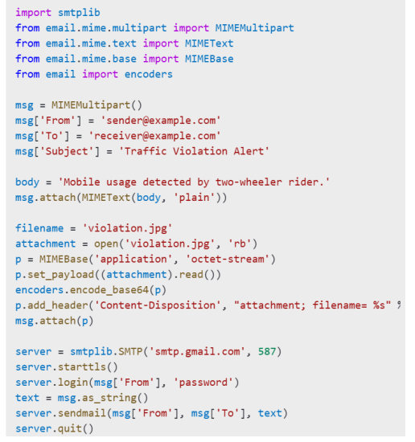
Python Code to send Email

Slide 19
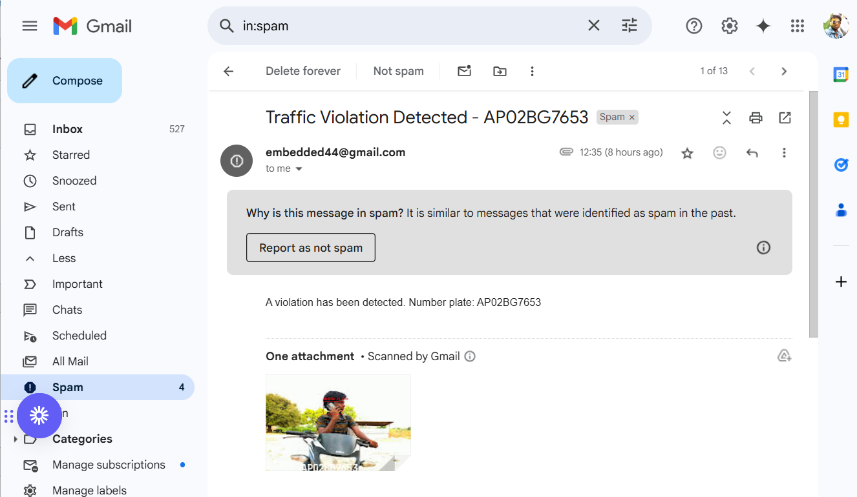
Output Email

Slide 20
Evaluation of detection and OCR
performance over video sequences
Video | FPS | Actual Violation | Detected Violation | Violation detection Error(%) | Violator’s Number Plate Detection Error(%)
Video1 | 12 | 5 | 5 | 0% | 0%
Video2 | 10 | 6 | 5 | 16.7% | 0%
Video3 | 7 | 7 | 6 | 14.3% | 16.7%
Video4 | 4 | 3 | 3 | 25% | 0%
Video5 | 5 | 4 | 3 | 20% | 20.9%
 | Total | 31 | 36 | 12.5% | 21.9%

Slide 21
Advantages and Applications
Advantages
Applications
• - Real-time
• - Automated
• - Efficient
• - Accurate
• - Road safety
• - Traffic monitoring
• - Vehicle enforcement
• - Automated ticketing

Slide 22
References
1. Redmon, J., Divvala, S., Girshick, R., & Farhadi, A. (2016). *You Only Look Once: Unified, Real-Time Object Detection*. In Proceedings of the IEEE Conference on Computer Vision and Pattern Recognition (CVPR), 779-788.
2. Zhang, Y., & Xie, L. (2019). *Real-time Object Detection for Mobile Applications Using YOLO*. International Journal of Computer Science and Information Security, 17(4), 23-29.
3. Kumar, A., & Singh, V. (2021). *Mobile Phone Detection for Traffic Safety Using Machine Learning*. Journal of Traffic Safety and Technology, 34(2), 123-132.

Slide 23
Conclusion
In conclusion, this project introduces an automated system that enhances road safety by detecting mobile phone usage among two-wheeler drivers in real time. By leveraging YOLO on a Raspberry Pi and integrating a USB camera with Tesseract OCR for number plate recognition, the system efficiently identifies distracted drivers and automates the ticketing process. The inclusion of an LCD display for presenting information, along with automated number plate extraction, ensures accurate and timely enforcement, contributing to safer driving behaviors and improved road safety.

